Slide 1
DJ deck

Slide 2
Scratch position
framesPerBeat = BufSampleRate.kr(bufnum) / trackTempo;
Because (frames/sec)/(beat/sec)

Slide 3
(mis)alignment
Scratching and pitchbending are done in the synthDef, causing a mismatch between the trackClock and the playback position in the synthDef
Upon switching between the two internal players, we can align them again, by making use of the information available in the comparison between playback and reference
Typically we want the tracks to align with the beatgrid later on, several scenarios:
Scratch was temporary, user likes to resume synced playback user needs to hit play again
Bending was temporary, user likes to resume synced playback press sync again
Scratch/bending was done since grid is not phase aligned properly, user likes to fix the new gridphase manual button
Scratch/bending is done, user is not interested in beatgrid at all sync=off

Slide 4
(mis)alignment
Previous approach was to calculate a gridOffset, and to take this into account when beat jumping
New approach
We sync the trackClock to the actual playback position whenever needed and possible -> the user should be unaware of this
If we have induced a gridOffset in order to phase sync the tracks manually, that is the two trackClocks are not phaseSynced, we can store this offset, and phaseSync the clocks again -> the user should know, weather the tracks are phase synced, tempo synced
Use scrup/skip button for phase sync, phase sync feedback, and (shift) storing gridOffset
In order to have the trackClock always in sync, the server should notify the language if for more than 1sec no pitch/seek action has taken place

Slide 5
Seperate issues
Misalignment between clock and actual playback position
Requires to align the clock with the actual playback position when we have reason to assume they got out of sync
Perhaps when aligning we should only set the clock, without the clock causing a beetjump; but in a perfect world, this beatjump is not noticeable
Manual changing the position of the grid with respect to the track
Requires to overwrite (or better store a secondary value, gridOffsetUser) of gridOffset
beat2PositonAdjusted should be rewritten and renamed into beat2position, same for other direction
When setting a que (not snapping), we should calculate the corresping gridOffsetUser, such that it is positive, but differs minimally from gridOffset
When gridOffsetUser is changed, always the clock should be aligned again, to make sure the clock reflects the new position of the grid
Only after the previous two steps shiyld setQue wrap up with storing the beat value

Slide 6
Overwriting gridoffset
When paused, we can manually set the grid at the beat
overwriteGridOffsetPaused
When playing and pitchshifting, we can move the track with respect to the masterclock, and we can store that. That way we can phasesync again.
overwriteGridOffsetFromMaster

Slide 7
104.2
107.8
master
deck
P
Q
11.75
15.3
userInducedGridOffset is time of first beat
So now the userInducedGridOffset should be such that the beat value at P is either 11.2 or 12.2, and at Q it should be 14.8 or 15.8.
Beat = (time – userInducedGridOffset ) * tempo;
Time = beat/tempo + userInducedGridOffset;
We want beatNew/tempo + GridOffsetNew = beatOld/tempo+ gridOffsetOld, because the time or position we are describing should remain unchanged
so gridOffsetNew = (beatOld – beatNew)/tempo + gridOffsetOld
We need the smallest possible gridOffset (corresponding to high beatValue), but it should be positive

Slide 8
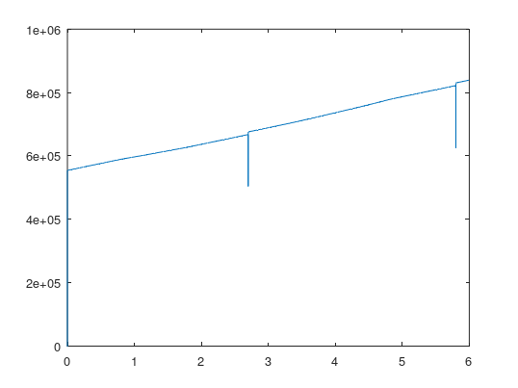
Alignment mismatcht
When we do an alignment (initiated by the server) we get a small glitch
Multiple problems
Why is there a dip?
Due control rate discrete steps, see next slide
Why do we jump ahead in time?
Might be due to an error in pos2beat or beat2pos
Might be due to numericalprecision issues
data_250226_160721.csv

Slide 9
Alignment mismatcht
Hypothesis inconsistency in beat to position mapping
Beat > position
beat2positionAdjusted in jumpToBeat
(((beat + setpointGridOffset) / trackTempo) + track.gridOffset) * track.sampleRate;
Position > beat
Position2beat in align
((position / track.sampleRate) * trackTempo);
Seems to indeed be inconsistent

Slide 10
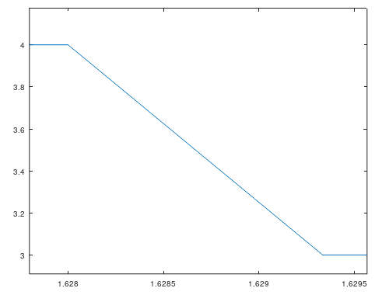
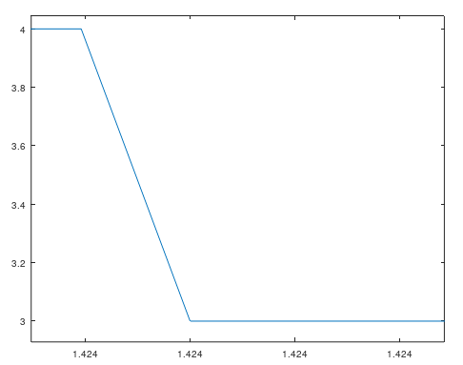
Handling control rate discrete steps
Basic approach
Better! approach
SynthDef("testK2A",{
var out;
out = In.kr(b);
Out.ar(~bScopeAr,K2A.ar(out));
}).add;
SynthDef("testK2A",{
var in, out;
in = In.kr(b);
out = Latch.ar(in,T2A.ar(Changed.kr(in)));
Out.ar(~bScopeAr.index,out);
}).add;
Linear interpolation over the period of the blocksize
Immediate

Slide 11
SetQue
Sync / no sync
Typically snap to nearest beat
When shift, do not snap, and set gridOffsetActual as the setpoint

Slide 12
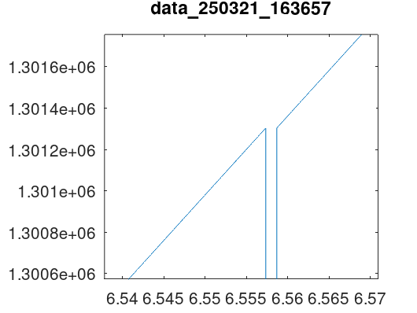
21-03 fixed beat conversion inconsistency
Result is looking quite good, but I have not yet accounted for the control rate discrete steps issues

Slide 13
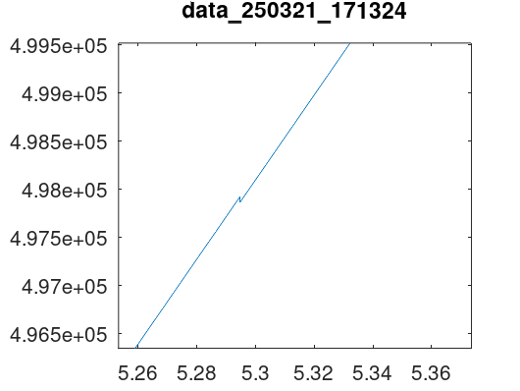
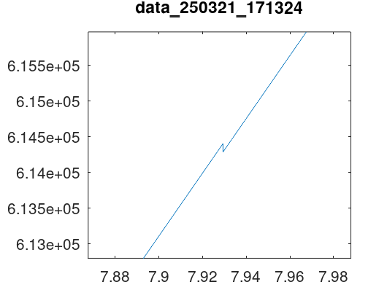
21-03 partial fix of discrete step

Slide 14
21-03
Quantify jump performance with and without the discrete step fix
Find out how it is possible that we are jumping backward now
Maybe due to the actual value allready having increased in the mean time since we have proped it
Maybe we can consider the jump to be small enough, and
leave it for now (open to do to decrease the jump error);
Implement alignment without beatjumping (since the core task is to set the clock at the position of the track, the track may run freely itself
We should align before beatjumping and stuff like that, and when pausing
jumping
probing

Slide 15
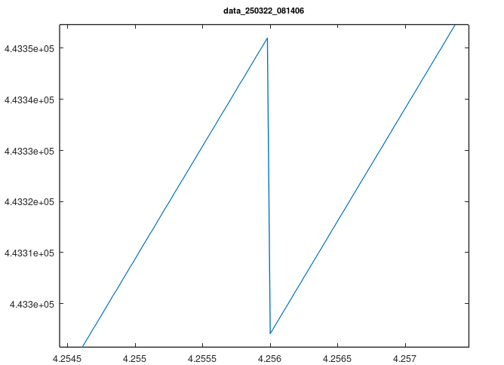
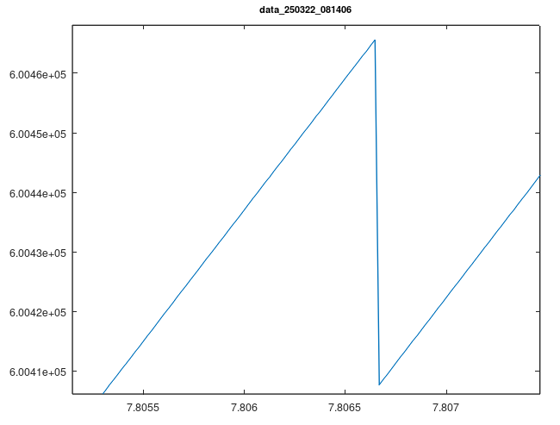
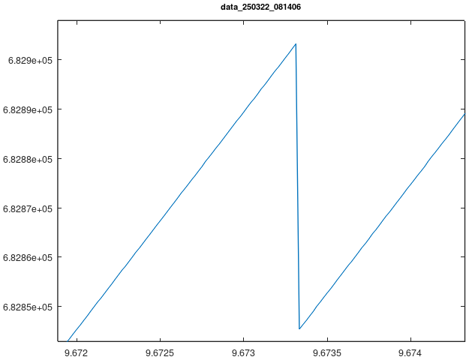
22-03 jump size with discrete fix
1000/s.sampleRate*s.options.blockSize;
// blocksize in ms
= 1.333ms
4.2560-4.2547=0.0013s=1.3ms
7.8067-7.8053=0.0012s=1.2ms
9.6733-9.6720=0.0013s=1.3ms
So precisely one blocksize, one control cycle; is this artefact due to reading at the one control cycle and adjusting at the other; or is it an artefact in the discrete fix

Slide 16
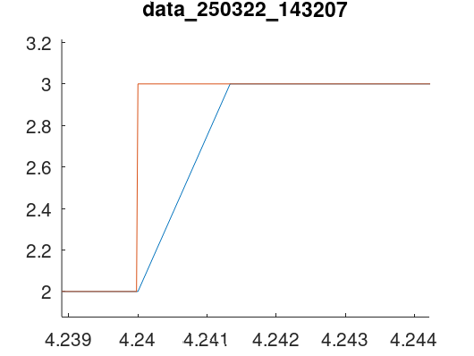
Check wether discrete jump is working
Use multichannel timetrace to see wether jump accors directly when value is written, so make combined timetrace of both plots of slide 10
Blue is the normal K2A, and red is my discrete algorhythm
Clearly they start at the same moment;
No reason to assume it happens one control cycle later

Slide 17
How does the error occur?
Edge detected jump to value written down earlier
playerselection is control rate
Jumping executed in language, hence write playerSelection
Discretization of position in order to write to control bus from which we read synchronous
Probing, write down value

Slide 18
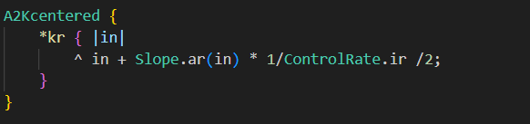
Design flaw of referenceBus for obtaining position
Because we can only getSynchronous from control rate bus, the position is converted from audio rate to control rate; assume position is increasing, then we always have a skewed error; it is better to center the error, than the average error is zero, and the variance is also lower;
So we want ->
Make a dummy variable, which has an increment/decrement proportional to the slope, and discretize that one
Dummy = original + slope*blocksize/2

Slide 19
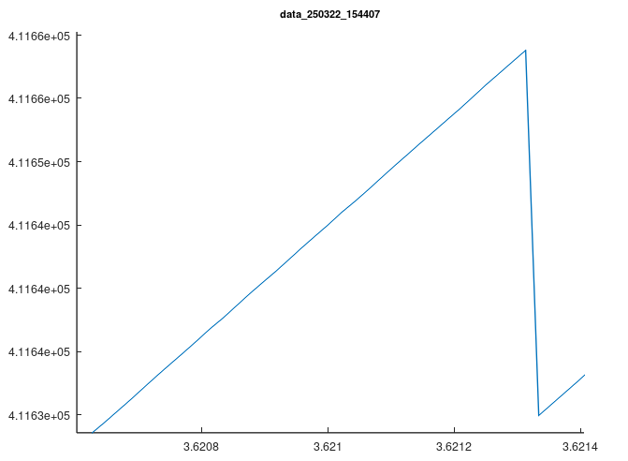
With improved centered discretization
3.62133-3.62065 = 0.00068s = 0.68ms

Slide 20
Wrapping up
Reading of current position is as accurate as possible;
We disable jumping upon alignment, because not necessary
We decrease the wait time from 1s to 0.5s
Make sure reference position does not come up on language side, but keep the bus and server side structure in place, might come in handy later

Slide 21
Testing
Test beatjumping or alignment, when tempo is negative; new change to trackClock.beats_;
Test whether alignment and userGridOffset work properly
To be done

Slide 22
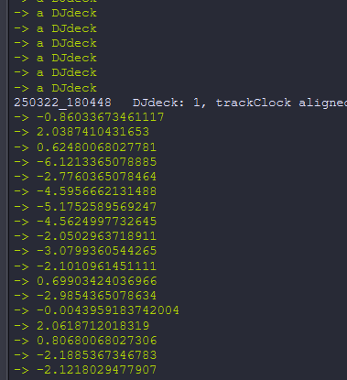
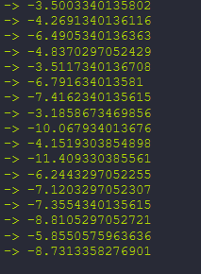
Time difference clock and track
~deck1.position2time(~deck1.referenceBus.getSynchronous)-~deck1.beat2time(~deck1.clock.beats))*1000
Without pitchshifting
So in the order of 10ms
TrackClock is prefect wrt SystemClock
~deck1.beat2time(~deck1.clock.beats)-SystemClock.seconds;
Pitch shifting
- With pitchshifting

Slide 23
Time difference clock and track
10ms is considerable; should be possible to get it tighther
Where does the difference arise?
Check scratch and remain 0 if no input is there
When does it become a problem?
If we also start scheduling other stuff, from the language
https://scsynth.org/t/imperfection-of-language-based-timing/350/10
I might want to stop using getSynchronous and instead use proper OSC bundles with timestamps, but for immediate events you don’t want scheduling of OSC bundle, instead you want OSC message, which is processed as fast as possible, but I think that does not offer sample accuracy; if sample accuracy is desired I should run some reference clock on the server..
AP

Slide 24
Tempo difference between language and server
22-04
UMC at 41100Hz with 64 buffersize
Performing test 1, shows that d = o.getSynchronous - t.beats; // offset is steadily decreasing over time
UMC at 41100Hz with 512 buffersize
Performing test 1 again, similar results, also decreasing over time, but now slower
Apparantly this is a known issue, it is referred to as drift.
https://scsynth.org/t/keeping-sclang-and-scsynth-in-hard-sync/5526/7
https://scsynth.org/t/sweeping-through-a-buffer-in-sync-with-tempo/2621
https://scsynth.org/t/server-clock-vs-language-clock/9135/5
https://scsynth.org/t/imperfection-of-language-based-timing/350/19

Slide 25
Drift
Should come up with a mechanism to keep language and server synced, tackle separately
Drift
This solution https://scsynth.org/t/sweeping-through-a-buffer-in-sync-with-tempo/2621/6 might be fine; we periodically sync the server to the language; this does not interfer with our current system of adjusting the trackclock once we have tempobend, because the latter would run a level higher (as to say) as the former.
Jitter (not so important, discussed in previous slides)
AP

Slide 26
Looping
I should distinguish between two looping modes
Front (normal), start point of loop is fixed, length modulates the end point -> currently implemented
End, end point of loop is fixed, length modulates the start point
AP

Slide 27
Nice to haves
scratchTrig, and scratchTarget are processed in audio rate
If track is double speed, load at double speed
MidiButton([2, 12, ~mXone], BoolLangControllerTarget(~deck1, \userInducedGridOffsetSetpoint), mode: \direct); // TODO test and add for other decks ("adjust" button, next to sync); change to LangLangTarget
Rewrite beatJumpQuantized such that beat and q are no longer used confusingly

